Slide 1
CLASSIC SNAKE GAME
GROUPE : OKAY

Slide 2
Problem Statement
This project aims to build a snake game which satisfies the following requirements clearly :
  Obstacles will appear randomly to make it more challenging.
  Speed and size of snake must increase on eating a unit of food, this thus increasing difficulty as the game progresses.
  Game gets over as soon as a snake touches its own body or touches the wall.

Slide 3
What is a snake?
Here is the simplest idea of the snake game, you control the snake direction of motion and it moves forward; the goal is to collect the food then the snake becomes longer until you fail the gameover condition to end the game.

Slide 4
The snake game basically is based on a grid of rectangles; for the snake to draw itself on the grid it is going to have to calculate the grid and the cell coordonates so that it can draw itself not to mention that the grid dimention is constant.
Here is the design, we are going to create a board class and that is going to be responsible for drawing the grid to the screen and the snake and goal are going to draw themselves on the board, they are only going to know about the grid location in the grid space, the are not going to be aware of pixels.

Slide 5
now between our entities and board class we are going to have some functions and operations that deal with the grid space coordonates.
now let us talk about how the snake moves : for a delta location we will start moving from the the tail to the next segment the to the head, the head has nothing to follow therefore it moves to the delta location.

Slide 6
For polishing up we have added the border ,some obstacles randomly shows up on the grid as it progresses,it draws a title until you enter to start the game, the padding between the tails, the snake pattern to see clearly the movement of the snake, the snake speeds up over time
F16040109 mastermind coding game manager ,F16040118 game planning assistant ,F16040105 presentation game testing,F16040119 presentation game testing,F16040115 advisor ,F16040121 advisor

Slide 7
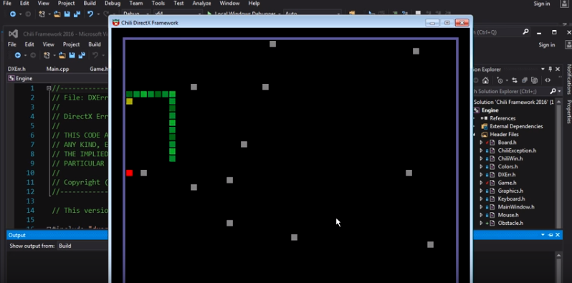
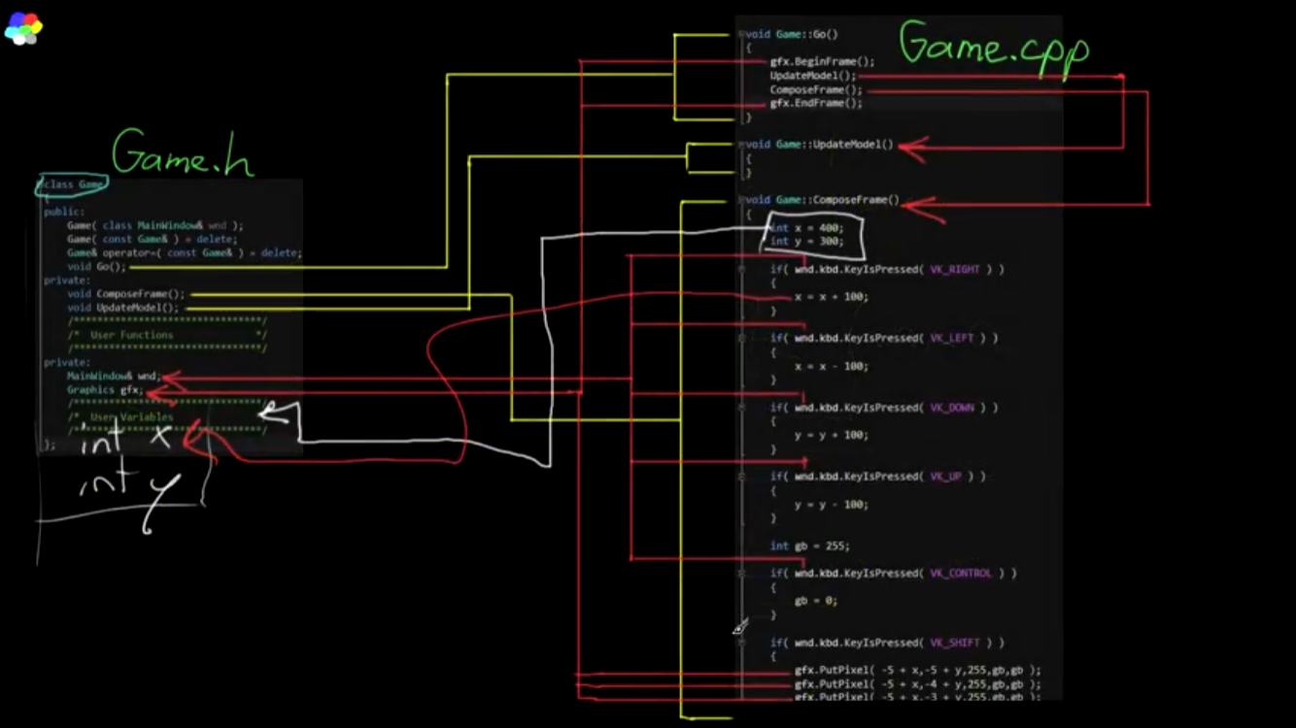
SNAKE GAME SNAPSHOT

